Slide 1
Preventing Overfitting
Problem:
We don’t want to these algorithms to fit to ``noise’’
The generated tree may overfit the training data
  Too many branches, some may reflect anomalies due to noise or outliers
  Result is in poor accuracy for unseen samples

Slide 2
Avoid Overfitting in Classification
Two approaches to avoid overfitting
  Prepruning: Halt tree construction early—do not split a node if this would result in the goodness measure falling below a threshold
    Difficult to choose an appropriate threshold
  Postpruning: Remove branches from a “fully grown” tree—get a sequence of progressively pruned trees
    Use a set of data different from the training data to decide which is the “best pruned tree”

Slide 3
Reduced-error pruning :
breaks the samples into a training set and a test set. The tree is induced completely on the training set.
Working backwards from the bottom of the tree, the subtree starting at each nonterminal node is examined.
If the error rate on the test cases improves by pruning it, the subtree is removed. The process continues until no improvement can be made by pruning a subtree, The error rate of the final tree on the test cases is used as an estimate of the true error rate.

Slide 4
Decision Tree Pruning:
physician fee freeze = n:
| adoption of the budget resolution = y: democrat (151.0)‏
| adoption of the budget resolution = u: democrat (1.0)‏
| adoption of the budget resolution = n:
| | education spending = n: democrat (6.0)‏
| | education spending = y: democrat (9.0)‏
| | education spending = u: republican (1.0)‏
physician fee freeze = y:
| synfuels corporation cutback = n: republican (97.0/3.0)‏
| synfuels corporation cutback = u: republican (4.0)‏
| synfuels corporation cutback = y:
| | duty free exports = y: democrat (2.0)‏
| | duty free exports = u: republican (1.0)‏
| | duty free exports = n:
| | | education spending = n: democrat (5.0/2.0)‏
| | | education spending = y: republican (13.0/2.0)‏
| | | education spending = u: democrat (1.0)‏
physician fee freeze = u:
| water project cost sharing = n: democrat (0.0)‏
| water project cost sharing = y: democrat (4.0)‏
| water project cost sharing = u:
| | mx missile = n: republican (0.0)‏
| | mx missile = y: democrat (3.0/1.0)‏
| | mx missile = u: republican (2.0)‏
Simplified Decision Tree:
physician fee freeze = n: democrat (168.0/2.6)‏
physician fee freeze = y: republican (123.0/13.9)‏
physician fee freeze = u:
| mx missile = n: democrat (3.0/1.1)‏
| mx missile = y: democrat (4.0/2.2)‏
| mx missile = u: republican (2.0/1.0)‏
Evaluation on training data (300 items):
Before Pruning After Pruning
---------------- ---------------------------
Size Errors Size Errors Estimate
25 8( 2.7%) 7 13( 4.3%) ( 6.9%) <

Slide 5
Evaluation of Classification Systems
Predicted
Training Set: examples with class values for learning.
Test Set: examples with class values for evaluating.
Evaluation: Hypotheses are used to infer classification of examples in the test set; inferred classification is compared to known classification.
Accuracy: percentage of examples in the test set that are classified correctly.
False Positives
True Positives
False Negatives
Actual

Slide 6
Model Evaluation
Analytic goal: achieve understanding
  Exploratory evaluation : understand a novel area of study
  Experimental evaluation : support or refute some models
Engineering goal : solve a practical problem
Estimator of classifiers : accuracy
  Accuracy : how well does a model classify
  Higher accuracy does not necessarily imply better performance on target task

Slide 7
Confusion Metrics
+
-
Actual Class
Y
A: True +
B : False +
Entries are counts of correct classifications and counts of errors
Predicted class
N
C : False -
D : True -
Other evaluation metrics
True positive rate (TP) = A/(A+C)= 1- false negative rate
False positive rate (FP)= B/(B+D) = 1- true negative rate
Sensitivity = true positive rate
Specificity = true negative rate
Positive predictive value = A/(A+B)‏
Recall = A/(A+C) = true positive rate = sensitivity
Precision = A/(A+B) = PPV

Slide 8
Probabilistic Interpretation of CM
Posterior probabilities
likelihoods
approximated using error frequencies
P (+) :
P (-)‏
prior probabilities approximated by class frequencies
P(+ | Y)‏
P(- | N)‏
P(Y |+)‏
P(Y |- )‏
Class Distribution
Defined for a particular training set
Confusion matrix
Defined for a particular classifier

Slide 9
More Than Accuracy
Cost and Benefits
  Medical diagnosis : cost of falsely indicating “cancer” is different from cost of missing a true cancer case
  Fraud detection : cost of falsely challenging customer is different from cost of leaving fraud undetected
  Customer segmentation : Benefit of not contacting a non-buyer is different from benefit of contacting a buyer

Slide 10
Model Evaluation within Context
Must take costs and distributions into account
Calculate expected profit:
profit = P(+)*(TP*B(Y, +) + (1-TP)*C(N, +))‏
+ P(-)*((1-FP)*B(N, -) + FP*C(Y, -))‏
Choose the classifier that maximises profit
Benefits of correct classification
costs of incorrect classification

Slide 11
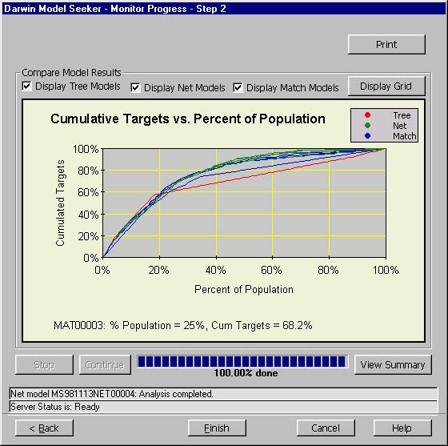
Lift & Cumulative Response Curves
Lift = P(+ | Y)/P(+) : How much better with model than without

Slide 12
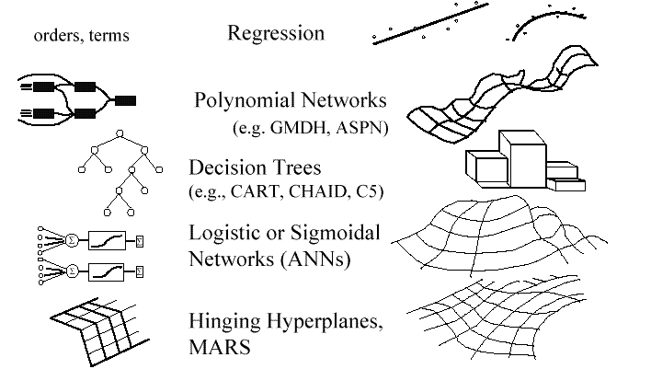
Parametric Models : Parametrically Summarise Data

Slide 13
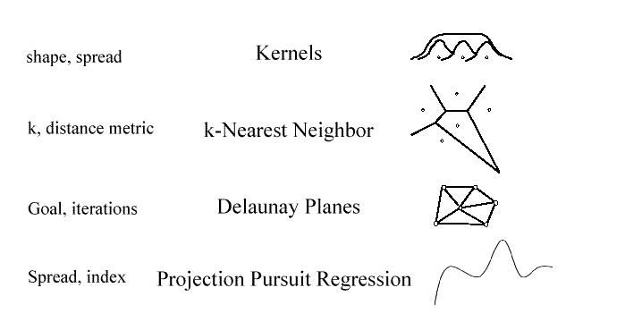
Contributory Models :
retain training data points; each potentially affects the estimation at new point

Slide 14
Neural Networks
Advantages
  prediction accuracy is generally high
  robust, works when training examples contain errors
  output may be discrete, real-valued, or a vector of several discrete or real-valued attributes
  fast evaluation of the learned target function
Criticism
  long training time
  difficult to understand the learned function (weights)‏
  not easy to incorporate domain knowledge

Slide 15
A Neuron
-
μ_{k}
x₀
w₀
x₁
w₁
∑
f
output y
x_{n}
w_{n}
Input
vector x
weight
vector w
weighted
sum
Activation
function
The n-dimensional input vector x is mapped into variable y by means of the scalar product and a nonlinear function mapping

Slide 16
Network Training
The ultimate objective of training
  obtain a set of weights that makes almost all the tuples in the training data classified correctly
Steps
  Initialize weights with random values
  Feed the input tuples into the network one by one
  For each unit
    Compute the net input to the unit as a linear combination of all the inputs to the unit
    Compute the output value using the activation function
    Compute the error
    Update the weights and the bias

Slide 17




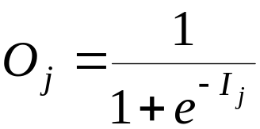
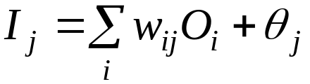
Multi-Layer Perceptron
Output vector
Output nodes
Hidden nodes
w_{ij}
Input nodes
Input vector: x_{i}

Slide 18
Instance-Based Methods
Instance-based learning:
  Store training examples and delay the processing (“lazy evaluation”) until a new instance must be classified
Typical approaches
  k-nearest neighbor approach
    Instances represented as points in a Euclidean space.
  Locally weighted regression
    Constructs local approximation
  Case-based reasoning
    Uses symbolic representations and knowledge-based inference

Slide 19
The k-Nearest Neighbor Algorithm
All instances correspond to points in the n-D space.
The nearest neighbor are defined in terms of Euclidean distance.
The target function could be discrete- or real- valued.
For discrete-valued, the k-NN returns the most common value among the k training examples nearest to xq.
Vonoroi diagram: the decision surface induced by 1-NN for a typical set of training examples.
_
.
_
_
.
+
_
.
+
.
.
_
xq
+
_
.
+

Slide 20
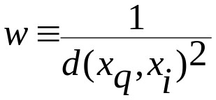
Discussion on the k-NN Algorithm
The k-NN algorithm for continuous-valued target functions
  Calculate the mean values of the k nearest neighbors
Distance-weighted nearest neighbor algorithm
  Weight the contribution of each of the k neighbors according to their distance to the query point x_{q}
    giving greater weight to closer neighbors
  Similarly, for real-valued target functions
Robust to noisy data by averaging k-nearest neighbors
Curse of dimensionality: distance between neighbors could be dominated by irrelevant attributes.
  To overcome it, axes stretch or elimination of the least relevant attributes.

